Slide 1

SQL Server Reporting Services 2008
Day 1
C3: Protected

Slide 2

About the Author
Created By: | Nalina Sivalingam (354725)
Credential Information: | Close to 6 years of experience as MSBI Developer
Version and Date: | SSRS 2008/1112/1.0
Cognizant Certified Official Curriculum

Slide 3









Icons Used
Hands on Exercise
Questions
Tools
Coding Standards
Test Your Understanding
Reference
A Welcome Break
Contacts
Demonstration

Slide 4
SSRS - Overview
Introduction
This chapter provides an overview of SSRS, its concepts and benefits.

Slide 5
SSRS - Agenda
The following topics are discussed in this session
Introduction & Benefits of SSRS
Report Server Architecture
Report Server Components
Report Categories
Reporting Life Cycle
Report Types
Report Scheduling

Slide 6
SSRS - Objectives
Objective:
After completing this session, you will be able to:
Understand the purpose of SSRS
Understand the Report Server Architecture, Components and Life Cycle
Describe the types of reports and scheduling mechanism
Able to develop reports using BIDS

Slide 7
Introduction to SSRS
SSRS is Microsoft’s answer to business reporting.
Microsoft introduced SSRS (SQL Server Reporting Services) in 2003 as a SQL Server 2000 add-on.
The introduction of SSRS also brought a new reporting XML standard called RDL (Report Definition Language).
SSRS comes along with SQL Server Installation under the same license.

Slide 8
Benefits of SSRS
SSRS Reporting Services allows us to quickly and easily create reports from multiple data sources.
Reports can be accessed from reporting services web browsers or custom applications
Reports can be extracted in multiple formats like XML, Excel, CSV, PD etc.
Reports can be distributed via Email, network shares, sharepoint.
One of the primary reasons that organizations implement Reporting Services is to provide managed reports to a large number of internal users

Slide 9
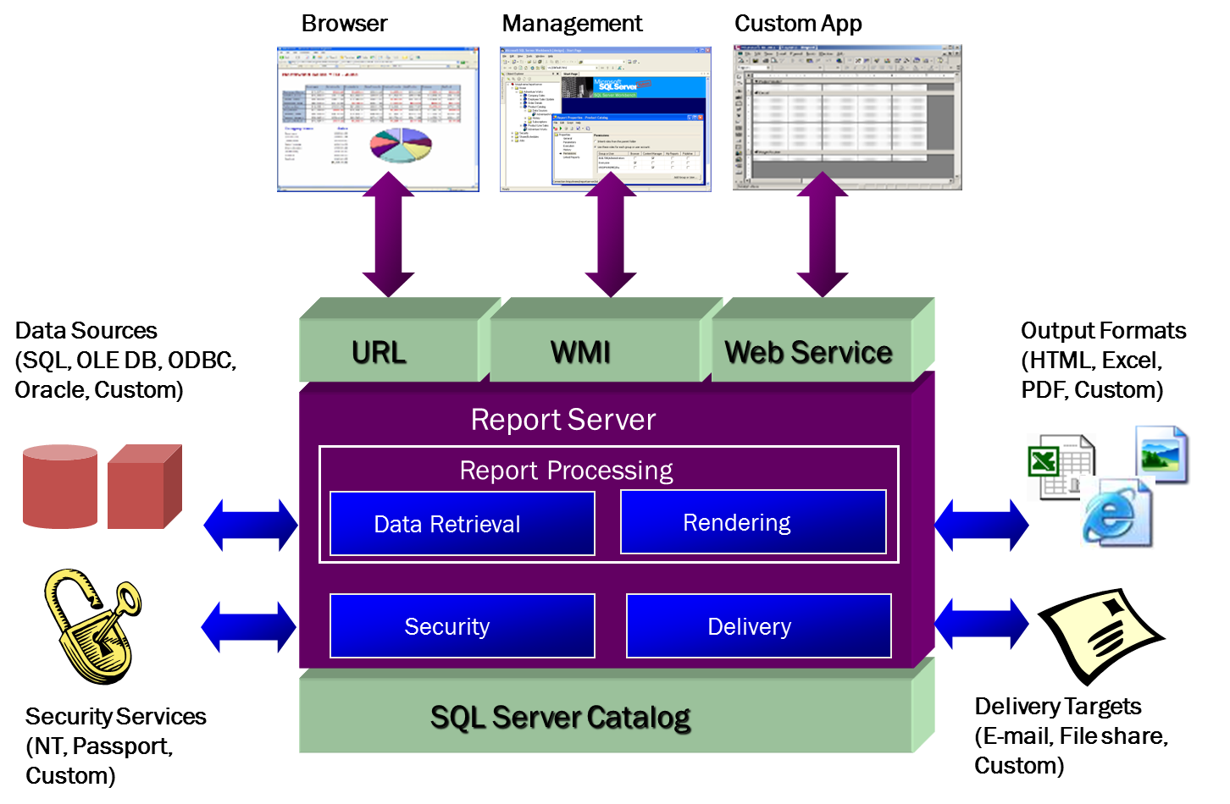
Reporting Services Architecture

Slide 10
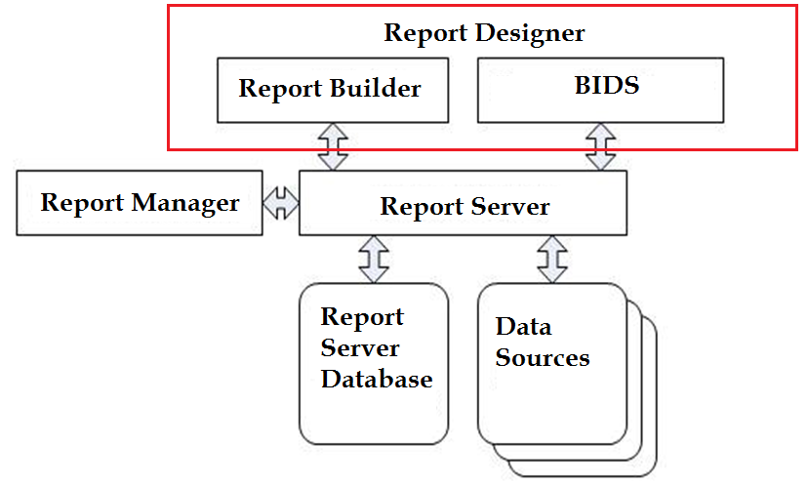
Reporting Services Components

Slide 11
Reporting Services Components (Contd.)
Report Server
It is the core engine that drives Reporting Services.
Report Manager
It is a Web-based administrative interface used for maintaining the published reports.
Data Sources
Reports can be created against any data source. This means we can easily retrieve data from SQL Server, Oracle, Analysis Services, Access and many other databases.

Slide 12
Reporting Services Components (Contd.)
Report Server Databases
Reporting Services creates and uses two SQL Server databases named ReportServer and ReportServerTempDB by default.
ReportServer Database
It is the repository for the reporting application data.
Has tables to store reports, data sources, snapshots, subscriptions, Schedule definitions etc
System properties and system-level security settings.
Report execution log data.

Slide 13
Reporting Services Components (Contd.)
ReportServerTempDB Database
The ReportServerTempDB database is used for temporary storage needs.
Store session data, cached reports and work tables that are generated by the report server.

Slide 14
Reporting Services Components (Contd.)
Report Designer
Report Designer provides the capability to design, develop, test and deploy reports.
Reporting Services includes two tools for creating reports.
Report Builder – Provides a simpler user interface for creating ad hoc reports, intended primarily at business users rather than developers
BIDS (Business Intelligent Development Studio) – A developer centric client tool, installed in development environment and used by developers.

Slide 15
Report Categories
Managed Report
detailed operational data.
gathered from a variety of data sources.
organized into a central repository.
Standard formatting.
Ad hoc Report
Report Builder.
users with limited technical skills.
simple reports saved privately or shared.
Embedded Report
portals or custom applications.

Slide 16
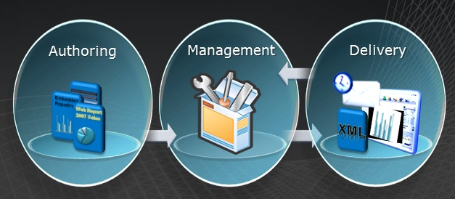
Reporting Life Cycle
SQL Server Reporting Services supports the full reporting lifecycle, including Authoring, Management and Delivery

Slide 17
Reporting Life Cycle (Contd.)
Report Authoring
Reporting specialist and end users authors(ad-hoc reports) fall under this.
Report development
Tools : BIDS, Report Builder

Slide 18
Reporting Life Cycle (Contd.)
Report Management
Manage the technical environment for the reporting platform.
Published reports are organized, secured and configured for end users.
Content Management is handled in this phase
Tools : Report Manager, RS Configuration Manager

Slide 19
Reporting Life Cycle (Contd.)
Report Delivery
This phase comes in, once the reports are deployed.
Mode of delivery like on demand, subscription
Tools : Report Manager, SharePoint, Excel, Web Browsers, Custom Applications.

Slide 20
Types of Reports
Parameterized reports
Ad hoc reports
Drilldown reports
Drillthrough reports
Subreports
Cached reports
Snapshot reports

Slide 21
Types of Reports (Contd.)
Parameterized Reports
A parameterized report uses input parameter to complete report processing.
The output vary based on the values that are set when the report runs.

Slide 22
Types of Reports (Contd.)
Ad hoc Reports
Can be created from an existing Report Model using Report Builder.
Ad hoc reports refer specifically to Report Builder reports.
Ad hoc reports can be saved and run locally or published to a report server, just like other Reporting Services reports.

Slide 23
Types of Reports (Contd.)
Drilldown Reports
Drilldown reports initially hide complexity and enable the user to toggle the hidden report items according to the detailed data they want to see.
Best example of Drilldown report is Sale information for the Year, then drill down for Quarters followed by Months and week.

Slide 24
Types of Reports (Contd.)
Drillthrough Reports
Are standard reports that are accessed through a hyperlink on a report item in the original report.
The main report displays summary information.
For example in a matrix or chart. Actions defined in the matrix or chart provide drillthrough links to reports that display greater details based on the aggregate in the main report.

Slide 25
Types of Reports (Contd.)
SubReports
A subreport displays another report inside the body of a main report.
A subreport is used to embed a report within another report. Any report can be used as a subreport.

Slide 26
Types of Reports (Contd.)
Performance Oriented Reports
Cached Reports
Snapshot Reports
Cached reports
A cached report is a saved copy of a processed report.
These reports are used to improve performance by reducing the number of processing requests to the report processor and by reducing the time required to retrieve large reports.

Slide 27
Types of Reports (Contd.)
Snapshot Reports
Contains query results that were retrieved at a specific time.
Unlike on-demand reports, which get up-to-date query results when we run the report, snapshots reports are processed on a schedule and then saved to Report Server.
When we select a report snapshot to view, Report Server retrieves the stored report from the report server database and shows the data and layout that were captured for the report at the time the snapshot was created.

Slide 28
Types of Reports (Contd.)
Report snapshots serve three purposes:
Report history - by creating a series of report snapshots, we can build a history of a report that shows data changes over time.
Consistency - use report snapshots when we want to provide consistent results for multiple users who must work with identical sets of data. With volatile data, an on-demand report can produce different results from one minute to the next.
Performance - by scheduling large reports to run during off-peak hours, we can reduce processing impact on the Report Server during core business hours.

Slide 29
Scheduling Reports - Subscription
Subscription
A subscription of a report is an on-demand reporting which could be scheduled and the delivery of the report can be automated.
A subscription is processed in the report server and the delivered report can be shared in a folder of a file server or can be sent to email addresses.

Slide 30
Types of Subscriptions
Standard Subscription
Consists of static values that cannot be varied during subscription processing.
For each standard subscription, there is exactly one set of report presentation options, delivery options, and report parameters.

Slide 31
Types of Subscriptions (Contd.)
Data-Driven Subscription
Get subscription information at run time by querying an external data source that provides values used to specify a recipient, report parameters, or application format.
Consists of dynamic values that can be varied during subscription processing.
These types of subscriptions are typically created and managed by Report Server administrators.

Slide 32
Demo
Demo

Slide 33
Reference
MSDN website
www.dwbiconcepts.com
Disclaimer: Parts of the content of this course is based on the materials available from the Web sites and books listed above. The materials that can be accessed from linked sites are not maintained by Cognizant Academy and we are not responsible for the contents thereof. All trademarks, service marks, and trade names in this course are the marks of the respective owner(s).

Slide 34

You have successfully completed the SSRS session
Thank you!

